Slide 1
Supply Chain Management & Transportation Model
ENGINEERING MANAGEMENT
Chapter# 5, 11

Slide 2
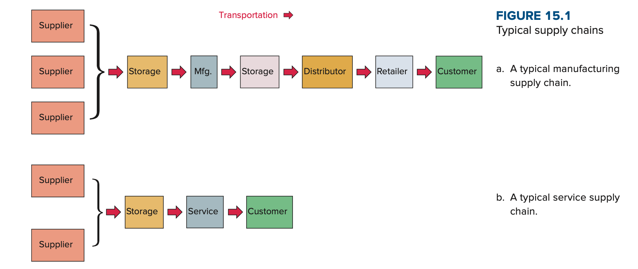
INTRODUCTION

Slide 3
INTRODUCTION
A supply chain is the sequence of organizations - their facilities, functions, and activities that are involved in producing and delivering a product or service.
❐ The sequence begins with basic suppliers of raw materials and extends all the way to their final customers.
❐ Facilities include warehouses, factories, processing centres, distribution centres, retail outlets, and offices.
❐ Functions and activities include forecasting, purchasing, inventory management, information management, quality assurance, scheduling, production, distribution, delivery, and customer service.

Slide 4
INTRODUCTION
❐ An important aspect of supply chain management is flow management.
❐ The three types of flow that need to be managed are product and service flow, information flow, and financial flow.
 Product and service flow involves the movement of goods or services from suppliers to customers, as well as handling customer service needs and product returns.
 Information flow involves sharing forecast and sales data, transmitting orders, tracking shipments, and updating order status.
 Financial flow involves credit terms, payments, and consignment and title ownership arrangements.

Slide 5
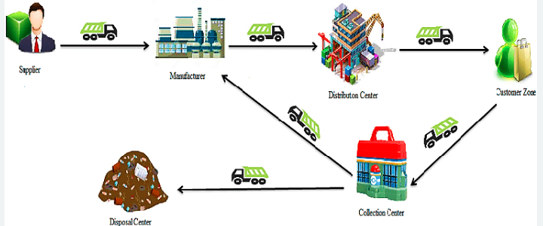
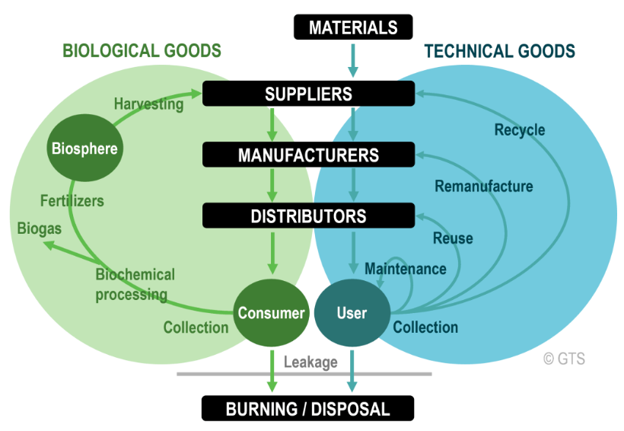
Closed loop supply chain and Circular Economy

Slide 6
LOGISTICS MANAGEMENT
Logistics refers to the movement of materials, services, cash, and information in a supply chain.
 Materials include all of the physical items used in a production process.
 In addition to raw materials and work in process, there are support items such as fuels, equipment, parts, tools, lubricants, office supplies, and more.
 Logistics includes movement within a facility, overseeing incoming and outgoing shipments of goods and materials, and information flow throughout the supply chain.

Slide 7
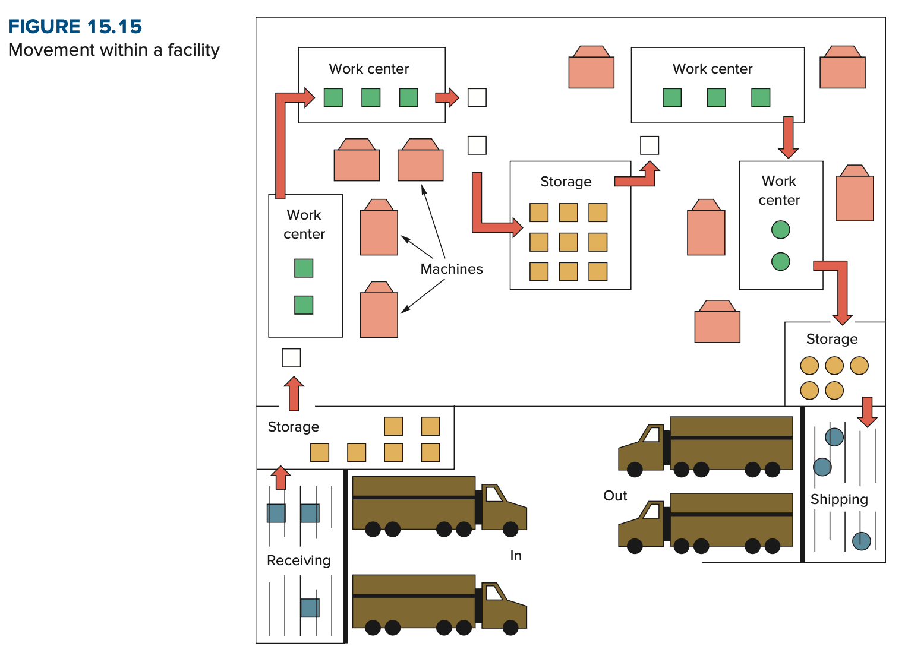
LOGISTICS MANAGEMENT
Movement within a Facility
Movement of goods within a manufacturing facility is part of production control.
The models shows the many steps where materials move within a manufacturing facility:
From incoming vehicles to receiving
From receiving to storage
From storage to the point of use (e.g., a work center)
From one work center to the next or to temporary storage
From the last operation to final storage
From storage to packaging/shipping
From shipping to outgoing vehicles

Slide 8
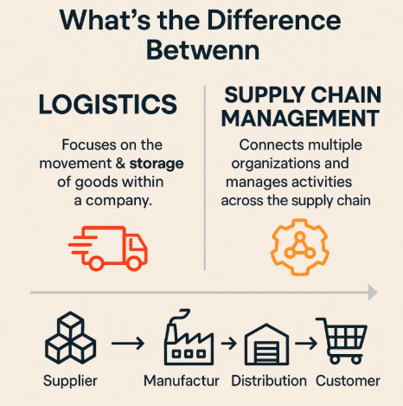

Slide 9
A Framework for Structuring Drivers
Competitive Strategy
Supply Chain Strategy
Efficiency
Responsiveness
Supply chain structure
Logistical Drivers
Facilities
Inventory
Transportation
Information
Sourcing
Pricing
Cross Functional Drivers

Slide 10
Drivers of Supply Chain Performance
Facilities
 places where inventory is stored, assembled, or fabricated
 production sites and storage sites
 Inventory
 raw materials, WIP (work in progress), finished goods within a supply chain
 inventory policies
 Transportation
 moving inventory from point to point in a supply chain
 combinations of transportation modes and routes

Slide 11
Drivers of Supply Chain Performance
 Information
 data and analysis regarding inventory, transportation, facilities throughout the supply chain
 potentially the biggest driver of supply chain performance
 Sourcing
 functions a firm performs and functions that are outsourced
 Pricing
 Price associated with goods and services provided by a firm to the supply chain

Slide 12
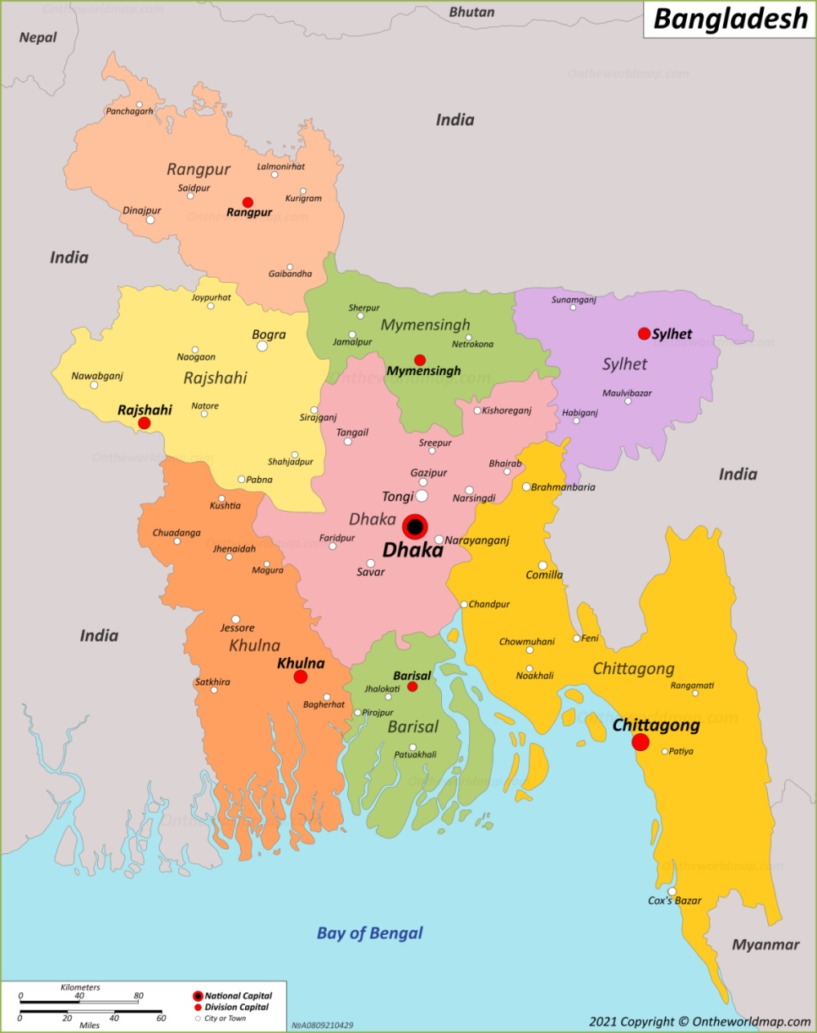

What is TRANSPORTATION MODEL?
Transportation Model is a special case of LPP (Linear Programming Problem) in which the main objective is to transport a product from various sources various destinations at total minimum costs.
Source 3
Destination 2
Source 2
Destination 1
Source 1
Destination 3

Slide 13
What is TRANSPORTATION MODEL?
Supply Origin
Demand Destination
D
Cost _{DA}
A
Cost _{DB}
Cost _{DC}
E
Cost _{EA}
B
Cost _{EB}
Cost _{EC}
Cost _{FA}
Cost _{FB}
C
F
Cost _{FC}

Slide 14
AIM OF TRANSPORTATION MODEL
◎ To find out the optimum transportation schedule keeping in mind the cost of transportation to be minimized.

Slide 15
What is TRANSPORTATION MODEL?
❐ Let, Company 1 produces S1 units,
Company 2 produces S2 units, and
Company 3 produces S3 units,
❐ Let, demand in City A is D1 units,
demand in City B is D2 units, and
demand in City C is D3 units

Slide 16
What is TRANSPORTATION MODEL?
The cost of transportation from each source to destination is given in table.
DESTINATIONS
SOURCES |  | CITY A | CITY B | CITY C | SUPPLY
 | COMPANY 1 | C_{1A} | C_{1B} | C_{1C} | S1
 | COMPANY 2 | C_{2A} | C_{2B} | C_{2C} | S2
 | COMPANY 3 | C_{3A} | C_{3B} | C_{3C} | S3
 | DEMAND | D1 | D2 | D3 | ∑D = ∑S
The transportation of mobile phones should be done in such a way, that the total transportation cost is minimum.

Slide 17
TYPES OF TRANSPORTATION PROBLEMS
There are two types of transportation problems.
i) Balanced Transportation Problems
The sum of supply and sum of demand are same.
∑ Supply = ∑ Demand
ii) Unbalanced Transportation Problems
The sum of supply and sum of demand are different.
∑ Supply ≠ ∑ Demand

Slide 18
Methods to solve transportation model
North-West Corner Method
Least Cost Method
Vogel's Approximation Method
Least cost method will not always provide minimum cost,
To identify minimum cost we need to solve the problem using Optimization techniques

Slide 19
LEAST COST METHOD

Slide 20
Methods to solve transportation model
ii. Least Cost Method
Sample Problem# 2
A mobile phone manufacturing company has three branches located in three different regions, say Barishal, Rajshahi, and Rangpur.
The company has to transport mobile phones to three destinations, say Dhaka, Sylhet and Chittagong.
The availability from Barishal, Rajshahi, and Rangpur is 40, 60 and 70 units respectively.
The demand at Dhaka, Sylhet, and Chittagong are 70, 40 and 60 respectively.
The transportation cost is shown in the matrix below (in Tk.).
Use the Least Cost Method to find a basic feasible solution (BFS).

Slide 21
Methods to solve transportation model
ii. Least Cost Method
Sample Problem# 2
DESTINATIONS
SOURCES |  | Dhaka | Sylhet | Chittagong | SUPPLY
 | Barishal | 4 | 5 | 1 | 40
 | Rajshahi | 3 | 4 | 6 | 60
 | Rangpur | 6 | 2 | 8 | 70
 | DEMAND | 70 | 40 | 60 | 170

Slide 22
Methods to solve transportation model
ii. Least Cost Method
Sample Problem# 2
Solution
Step 1: Balance the problem
The given Transportation problem is balanced as the ∑ Supply = ∑ Demand

Slide 23
Methods to solve transportation model
ii. Least Cost Method
Sample Problem# 2
Solution
DESTINATIONS
SOURCES |  | Dhaka | Sylhet | Chittagong | SUPPLY
 | Barishal | 4 | 5 | 1 (40) | 40
 | Rajshahi | 3 (60) | 4 | 6 | 60
 | Rangpur | 6 (10) | 2 (40) | 8 (20) | 70
 | DEMAND | 70 | 40 | 60 | 170
Total Transportation Costs = (1×40)+(3×60)+(6×10)+(2×40)+(8×20)
= Tk. 520​​/-

Slide 24
Unbalanced Transportation Problems

Slide 25
Methods to solve transportation model
Solve the following problem for BFS using Least Cost Method
Sample Problem# 4
Solution
Step 1: Balance the problem
The given Transportation problem is unbalanced as the
∑ Supply ≠ ∑ Demand
As the ∑ Supply = 115 and the
∑ Demand = 145
DESTINATIONS
SOURCES |  | A | B | C | SUPPLY
 | P | 5 | 1 | 7 | 20
 | Q | 7 | 4 | 6 | 70
 | R | 3 | 2 | 5 | 25
 | DEMAND | 65 | 30 | 50 | 145//115

Slide 26
Solution (With Dummy)
Solution
Step 1: Balance the problem (Using Dummy)
Therefore, Dummy Row ‘D₁” is added with the supply of 30 units in order to balance the Transport problem.
DESTINATIONS
SOURCES |  | A | B | C | SUPPLY
 | P | 5 | 1 | 7 | 20
 | Q | 7 | 4 | 6 | 70
 | R | 3 | 2 | 5 | 25
 | D₁ | 0 | 0 | 0 | 30
 | DEMAND | 65 | 30 | 50 | 145

Slide 27
Methods to solve transportation model
Solution
Step 5: After all allocations are over, write all the allocations and calculate the transportation cost.
DESTINATIONS
SOURCES |  | A | B | C | SUPPLY
 | P | 5 | 1 (20) | 7 | 20
 | Q | 7 (20) | 4 | 6 (50) | 70
 | R | 3 (15) | 2 (10) | 5 | 25
 | D₁ | 0 (30) | 0 | 0 | 30
 | DEMAND | 65 | 30 | 50 | 145
Total Transportation Costs = (1×20)+(7×20)+(6×50)+(3×15)+(2×10)+(0×30)
= Tk. 525​​/-

Slide 28
Solution (Without Dummy)
DESTINATIONS
SOURCES |  | A | B | C | SUPPLY
 | P | 5 | 1 (20) | 7 | 20
 | Q | 7 (20) | 4 | 6 (50) | 70
 | R | 3 (15) | 2 (10) | 5 | 25
 | DEMAND | 65 (30 unit extra) | 30 | 50 | 145/115
Total Transportation Costs = (1×20)+(7×20)+(6×50)+(3×15)+(2×10) = Tk. 525​​/-

Slide 29
Dummy: How to consider it
NOTE
If the sum of demand is less than the sum of supply, then we will have to add a “Dummy Column”.
DESTINATIONS
SOURCES |  | A | B | C | SUPPLY
 | P | 5 | 1 | 7 | 65
 | Q | 7 | 4 | 6 | 30
 | R | 3 | 2 | 5 | 50
 | DEMAND | 20 | 70 | 25 | 115//145

Slide 30
Methods to solve transportation model
NOTE
In order to balance the Transportation problem, we have to add “0” in the “Dummy Column” having demand of 30
DESTINATIONS
SOURCES |  | A | B | C | D₁ | SUPPLY
 | P | 5 | 1 | 7 | 0 | 65
 | Q | 7 | 4 | 6 | 0 | 30
 | R | 3 | 2 | 5 | 0 | 50
 | DEMAND | 20 | 70 | 25 | 30 | 145//145
Further, we can solve this by using any of the discussed method (NWCM, LCM or VAM)

Slide 31
Practice problem…
DESTINATIONS
SOURCES |  | D1 | D2 | D3 | D4 | SUPPLY
 | Q1 | 3 | 1 | 7 | 4 | 300
 | Q2 | 2 | 6 | 5 | 9 | 400
 | Q3 | 8 | 3 | 3 | 2 | 500
 | DEMAND | 200 | 350 | 400 | 200

Slide 32
Practical problem
Solution
DESTINATIONS
SOURCES |  | D1 | D2 | D3 | D4 | SUPPLY
 | Q1 | 3 | 1 (300) | 7 | 4 | 300 (0)
 | Q2 | 2 (250) | 6 | 5 (100) | 9 | 400 (100) (0)
 | Q3 | 8 | 3 (50) | 3 (300) | 2 (200) | 500 (300) (0)
 | DEMAND | 250 (0) | 350 (50) (0) | 400 (100) (0) | 200 (0)
Total cost: (1x300) + (2x250) + (5x100) + (3x50) + (3x300) + (2x200) = $2750

